Slide 1
Online Nursery
Presented By:
Mst.Mahbuba Nilufa Yasmin

Slide 2
Introduction

Slide 3
Online Nuursery is an online shop of gardening that offer various types of trees, seeds and gardening accessories for any types of gardeners.
Provide best customer service is our only priority. Therefore our motto is “Gardeners success is our happiness”

Slide 4
Development Resources

Slide 5
Bootstrap
HTML
CSS
JavaScript
PHP (to connect with database)
Xampp (for database)
Sublime for editor

Slide 6
Homepage

Slide 7
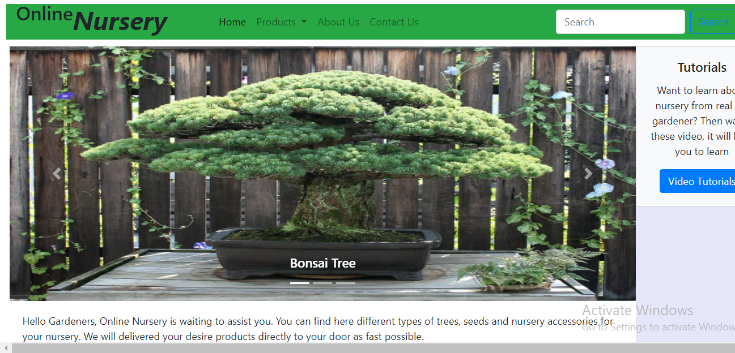

Slide 8
Main Objective

Slide 9
Our main objective is to offer customers with the best qualities of products at the reasonable prices. Because that will not only help gardeners, but make an impact on our environment.
We want to make an eternal change to our environment.

Slide 10
Why e-nursery.store

Slide 11
For any types of gardener
Special collection for small spaces (such as rooftop and lawn gardening.)
Best product at reasonable price
Save your valuable time

Slide 12
Marketing Plan

Slide 13
Online Advertisement (Facebook, Google and popular online sites)
Promotional offers
Complimentary gift with product
Promotional discounts
Free delivery
Stickers

Slide 14
Future Development

Slide 15
Launch the website on own domain name
Add Search Engine options
Connect every features with database
Add Expert Helpline Service
Add Gardener Community Corner.

Slide 16
Thanks

